Slide 1

FAR OUT
a hud redesign
annamaria koshy

Slide 2
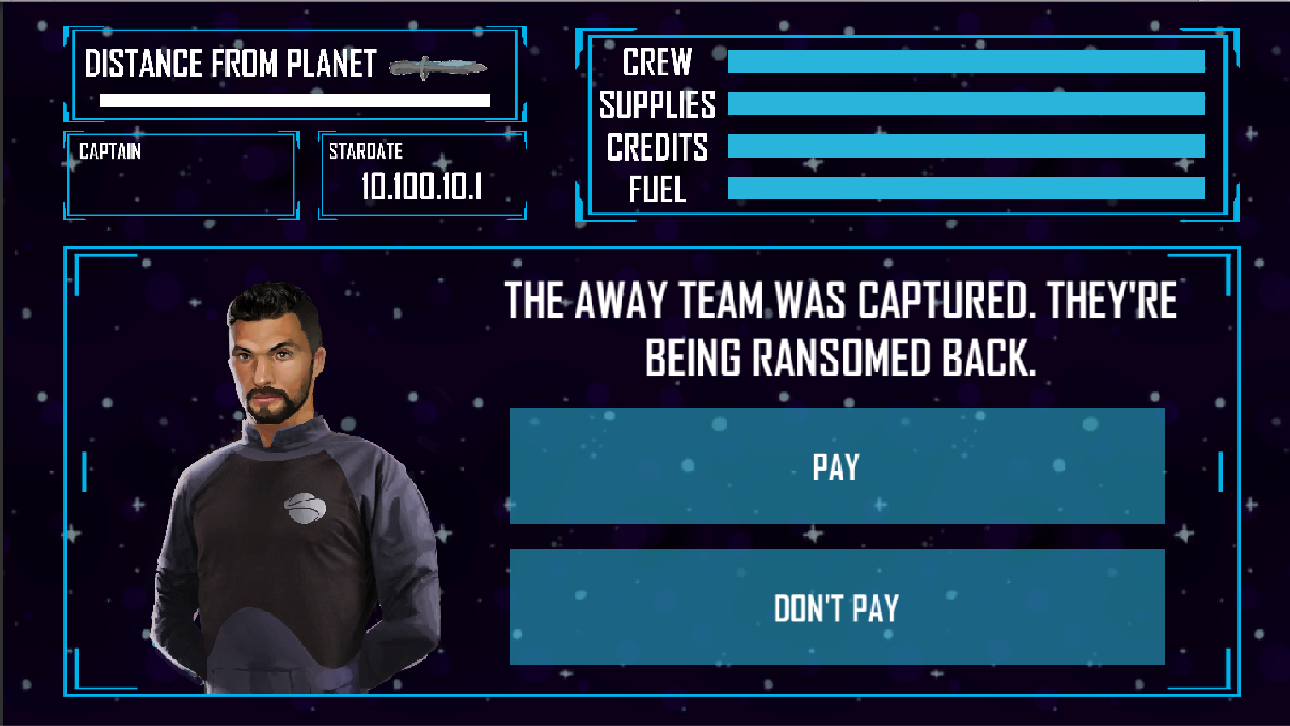
ORIGINAL
Notes:
> Horizontal to Vertical
> Added menus
More ‘moving parts’

Slide 3



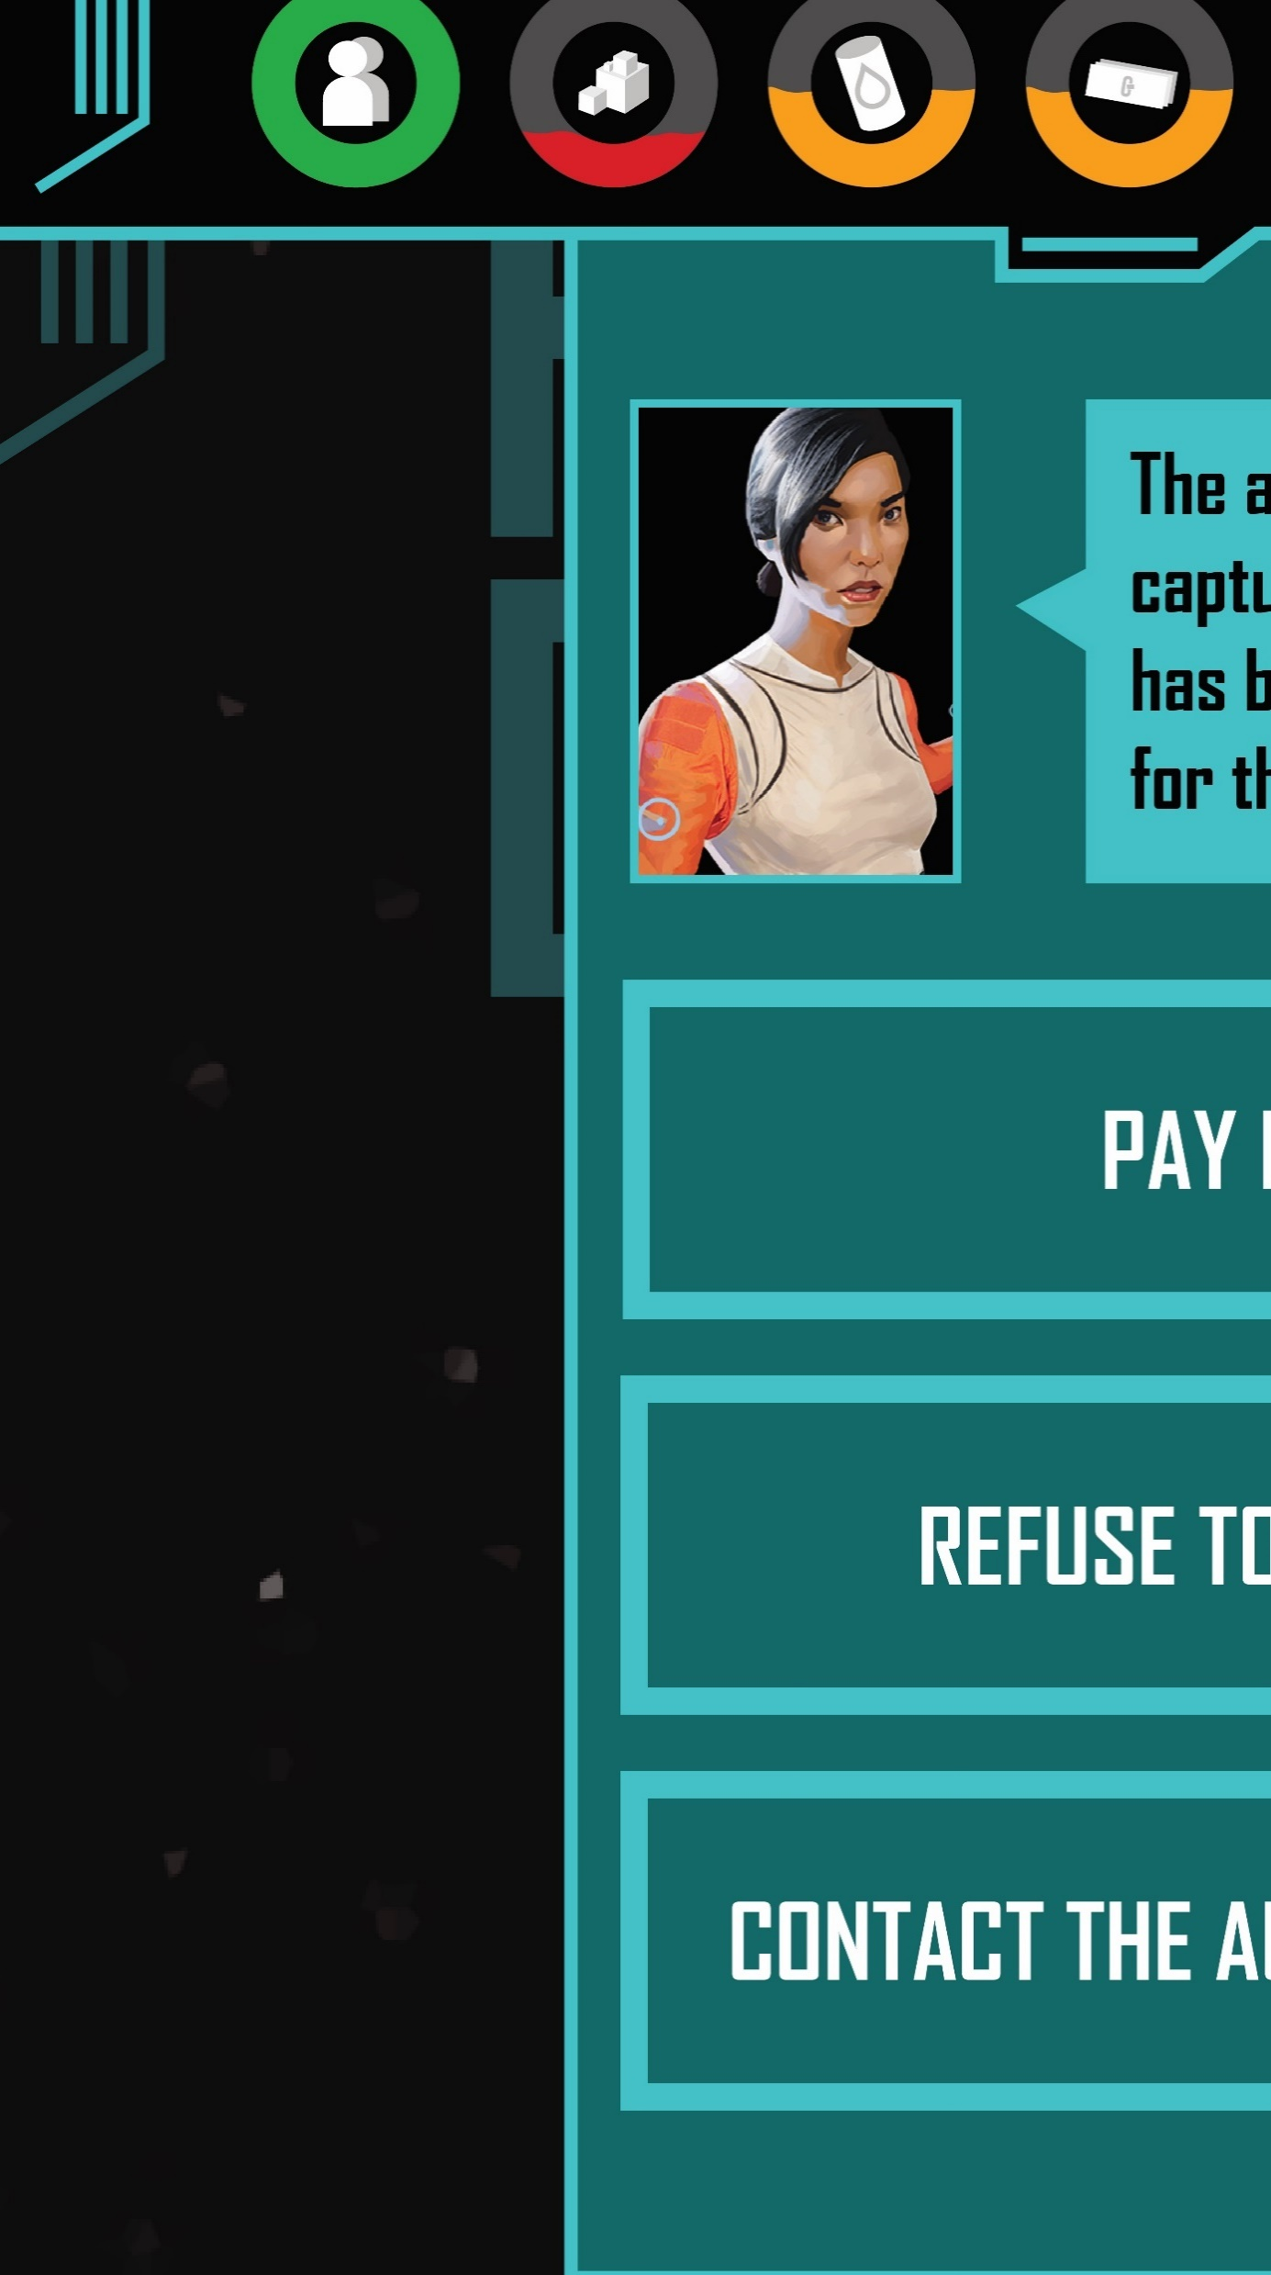
MAIN MENU

Slide 4

THE GAME

Slide 5
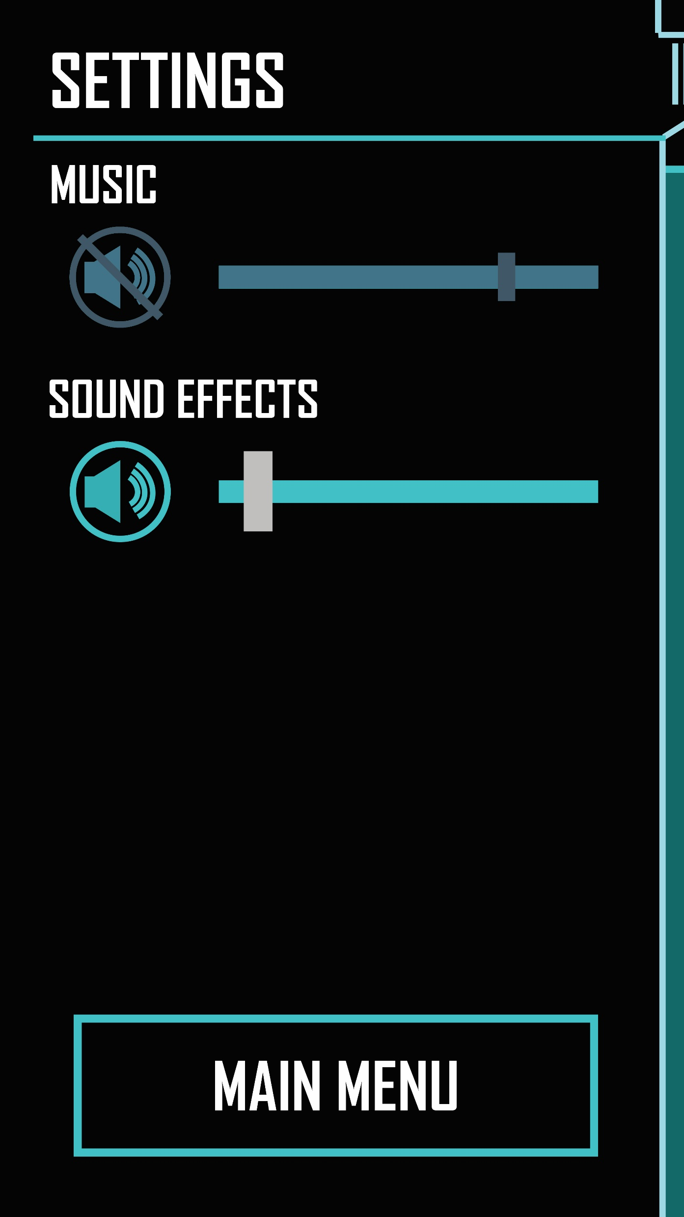

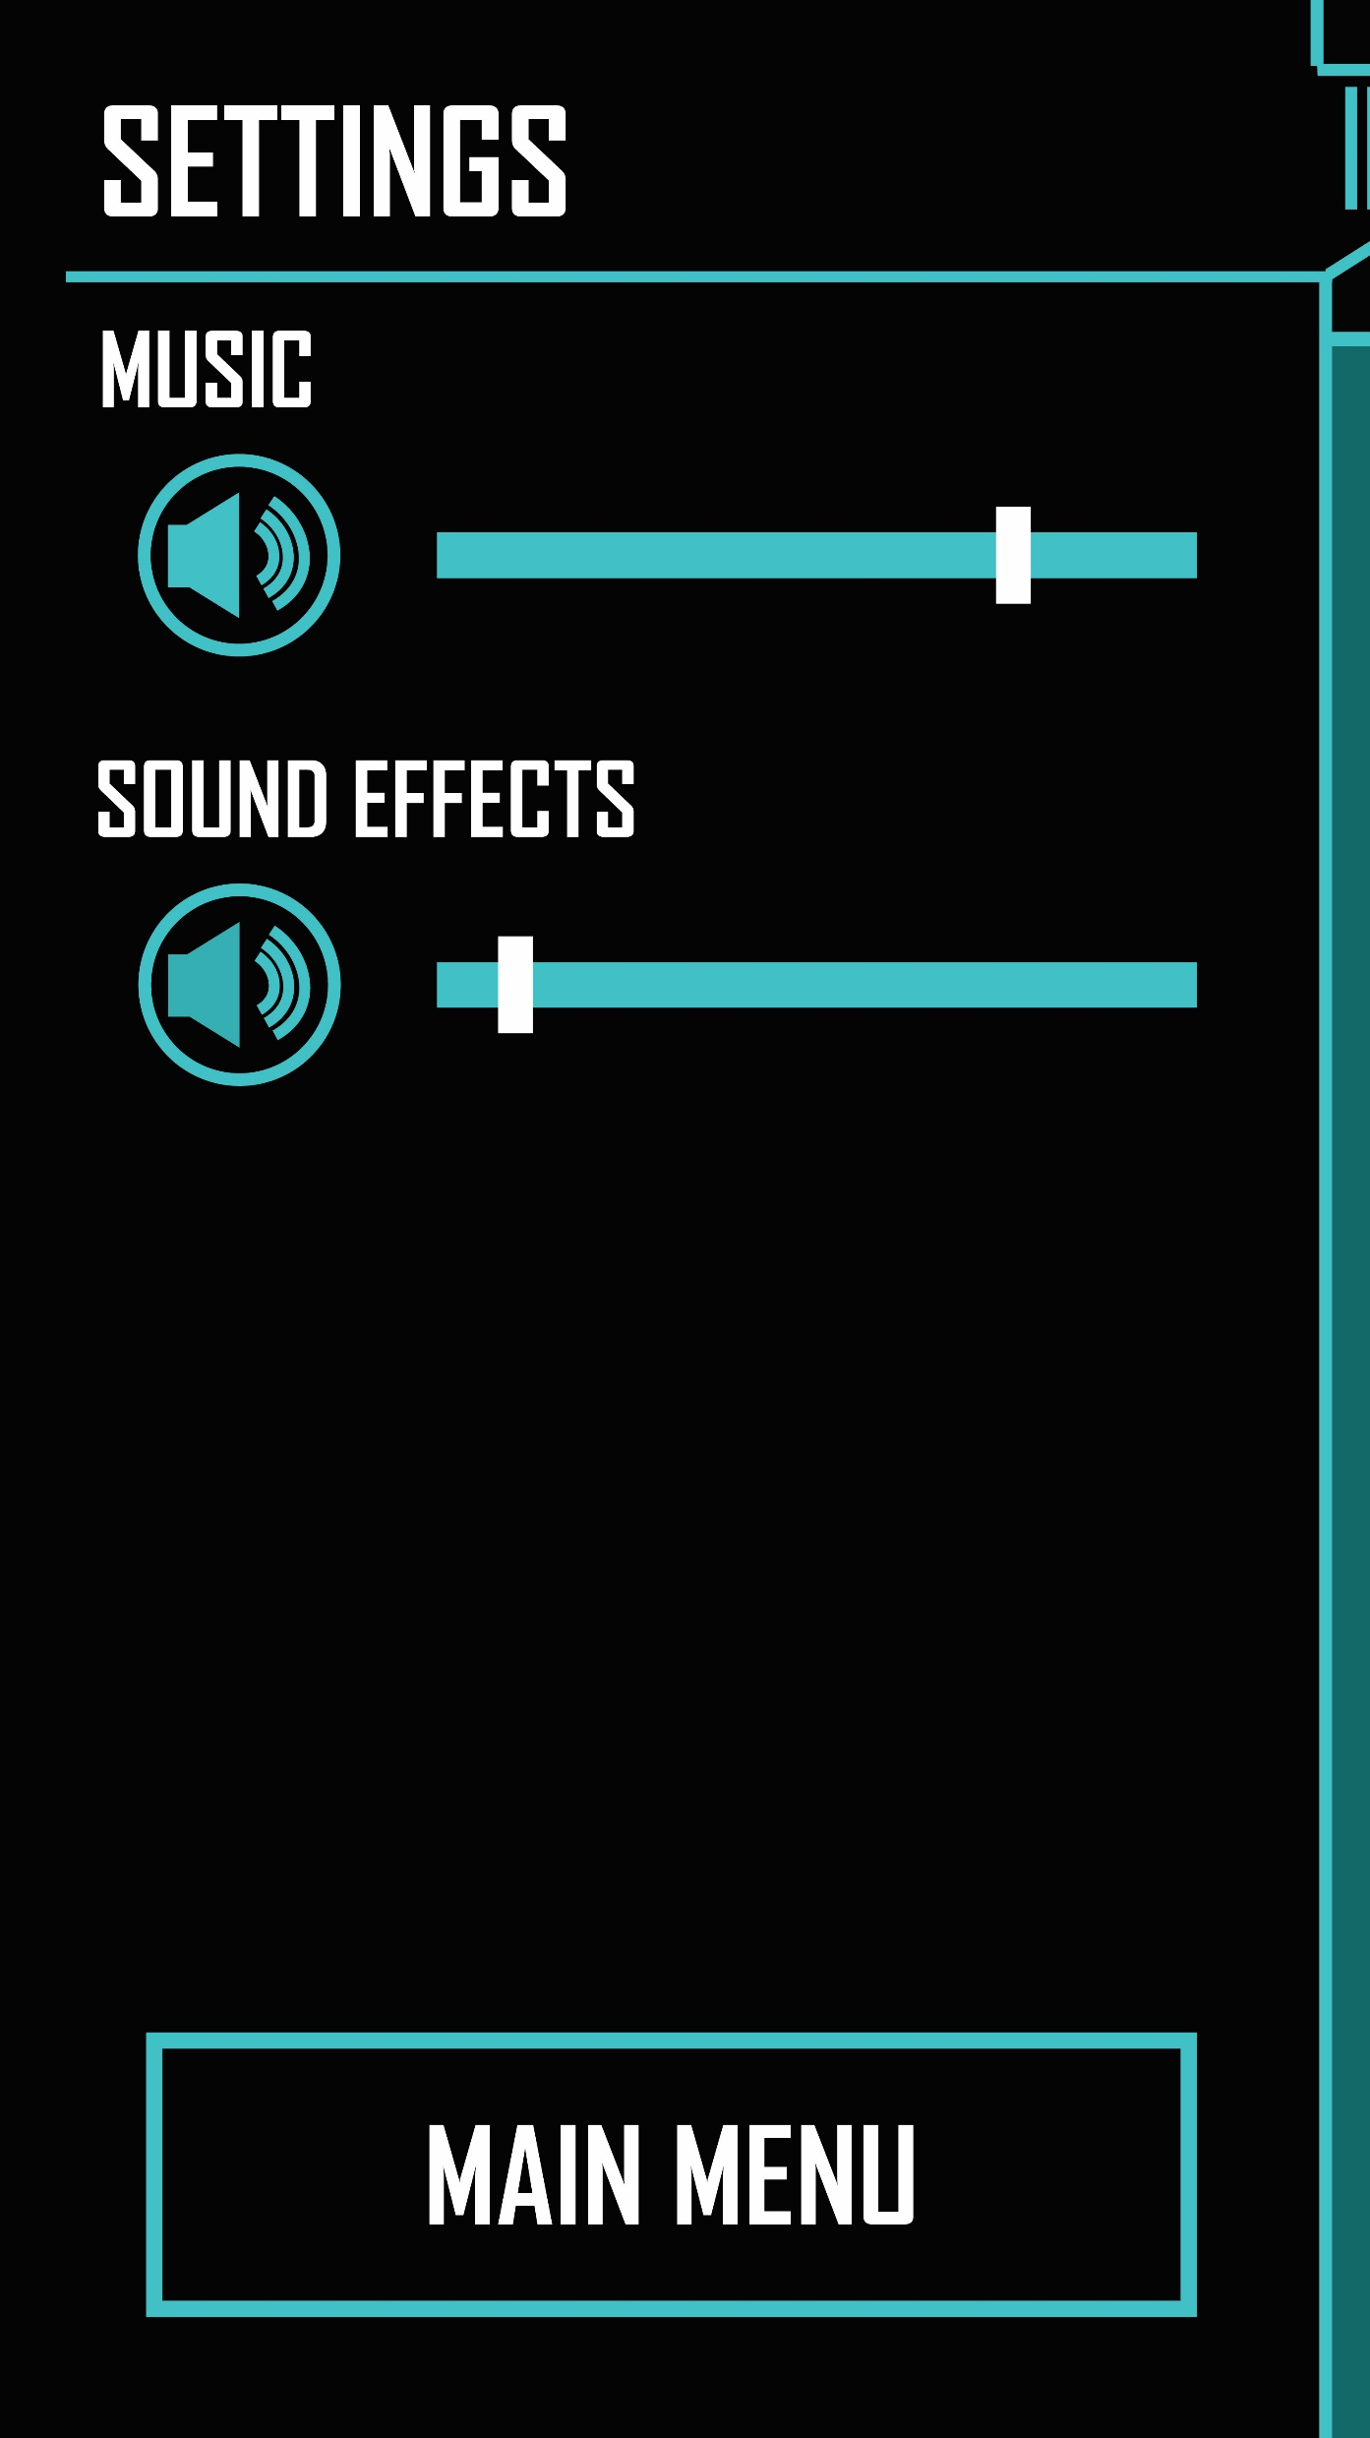
SETTINGS

Slide 6
THE GAME

Slide 7
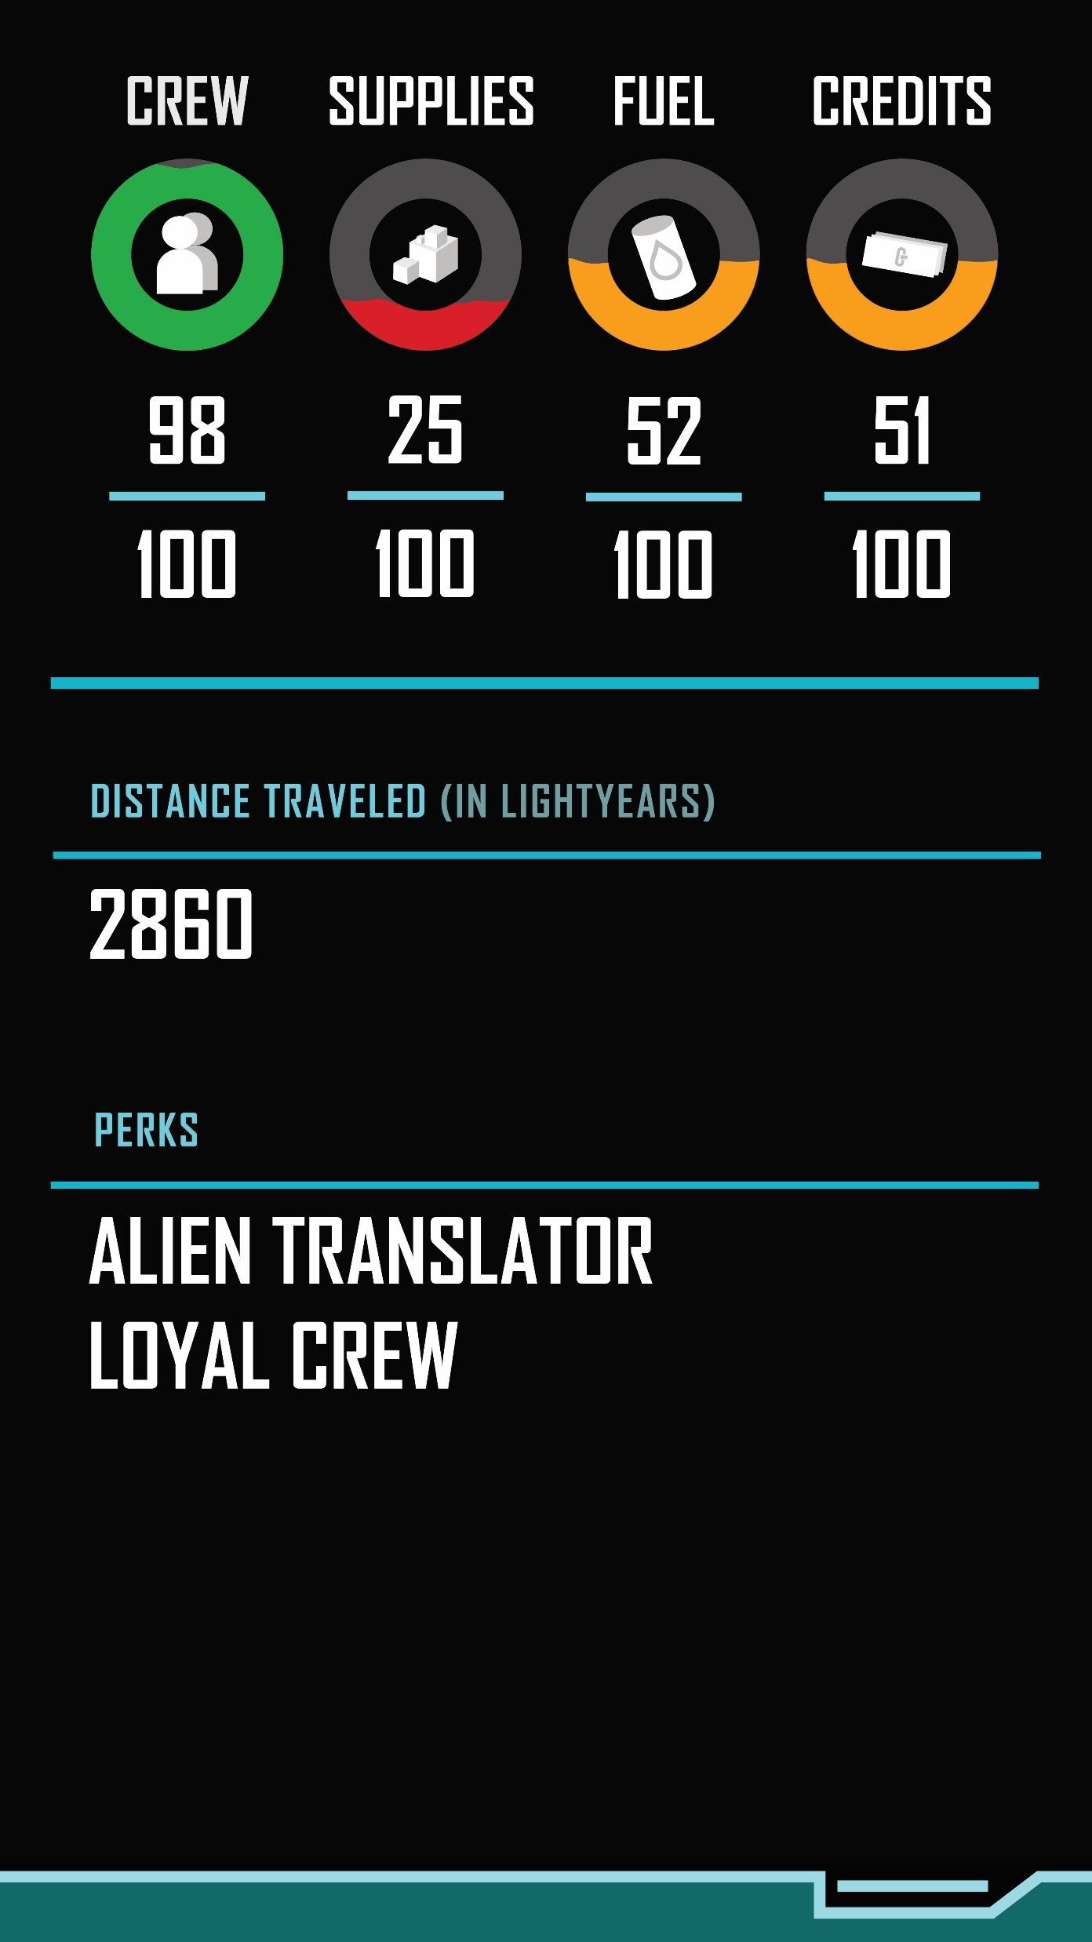
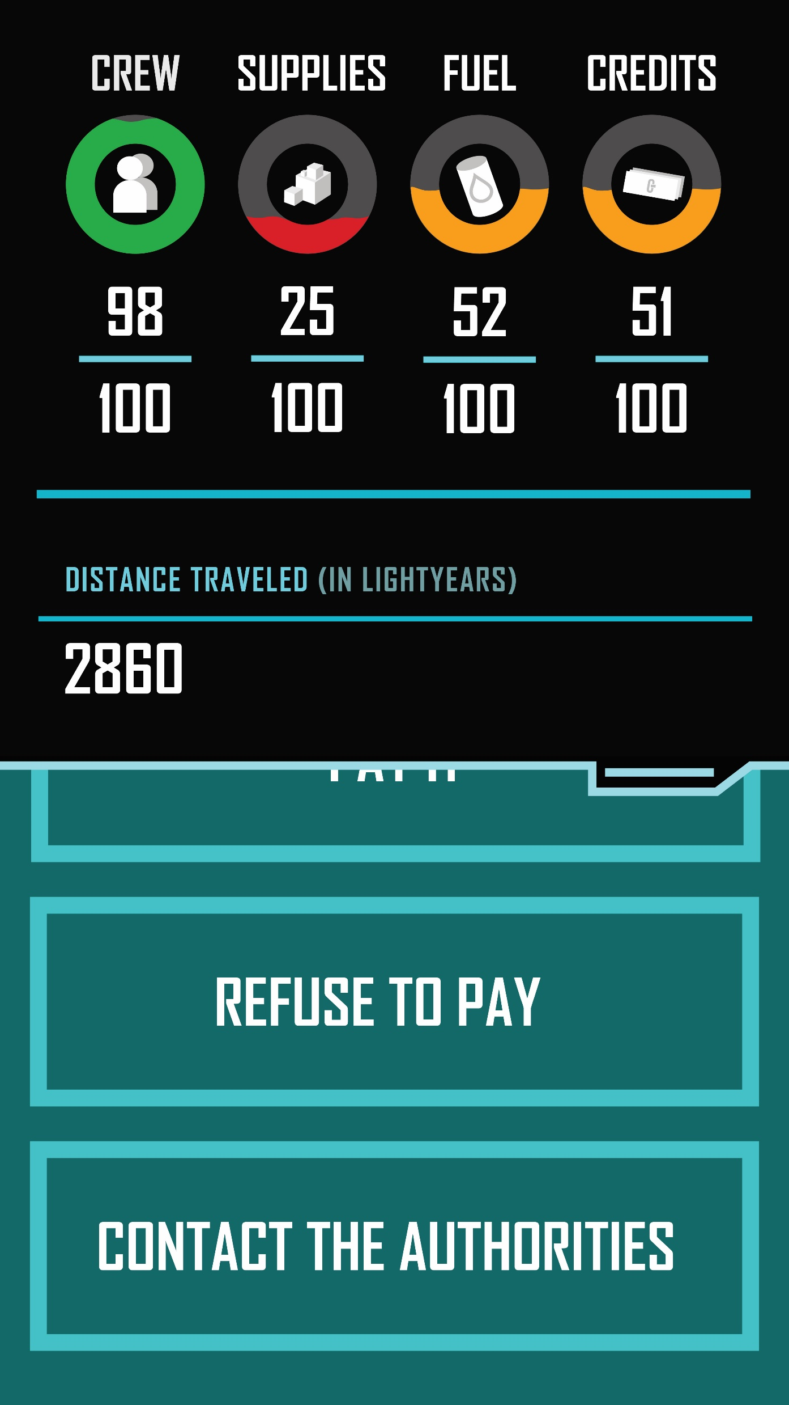


STATS

Slide 8



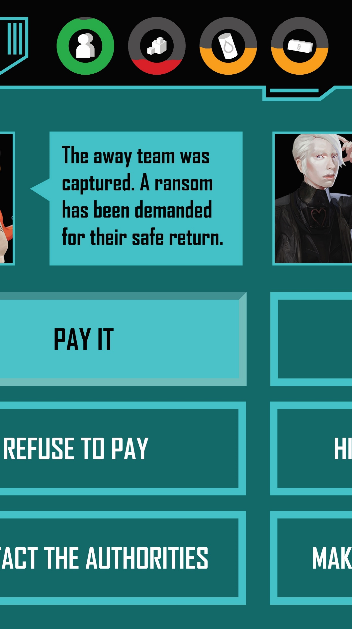
THE GAME

